Slide 2
An Online learning journal system.
Staff record children's progress and activities using tablet devices and PCs.
Parents can view their child’s journal on mobile devices and on their home computers, and can make observations of their own using a secure login system.
What Is Tapestry?

Slide 3
It creates a two way communication between us (the EYFS team), and you (the parents and carers).
We can upload flexible media meaning you can see pictures and videos of what your child is really up to at school.
Greater opportunities to extend your child’s learning at home – you can view next steps and communicate with us whenever you like.
Unlike a physical, hard copy book, it’s easy to share with groups of relatives, such as extended families, separated parents and relatives living overseas.
Why Are We Using Tapestry?

Slide 4
Photos, videos and observations are uploaded to Tapestry.
It is accessed via the Android/iOS app or the Tapestry website.
It enables you to comment on observations or add your own, so you can show us what your child is doing outside the school day – weekend trips, exciting learning opportunities, trip to the shops etc.
Email notifications can be sent to inform parents of new observations and comments.
How Does It Work?

Slide 5
A password is required to access Tapestry, and parents can only view observations of their own children.
Hosted on secure cloud servers within the EU.
Tapestry uses the same encryption as online banking.
Data is stored separately for each school.
Tapestry’s developers and support personnel require our permission to access our Tapestry account.
How Is The Data Protected?

Slide 6
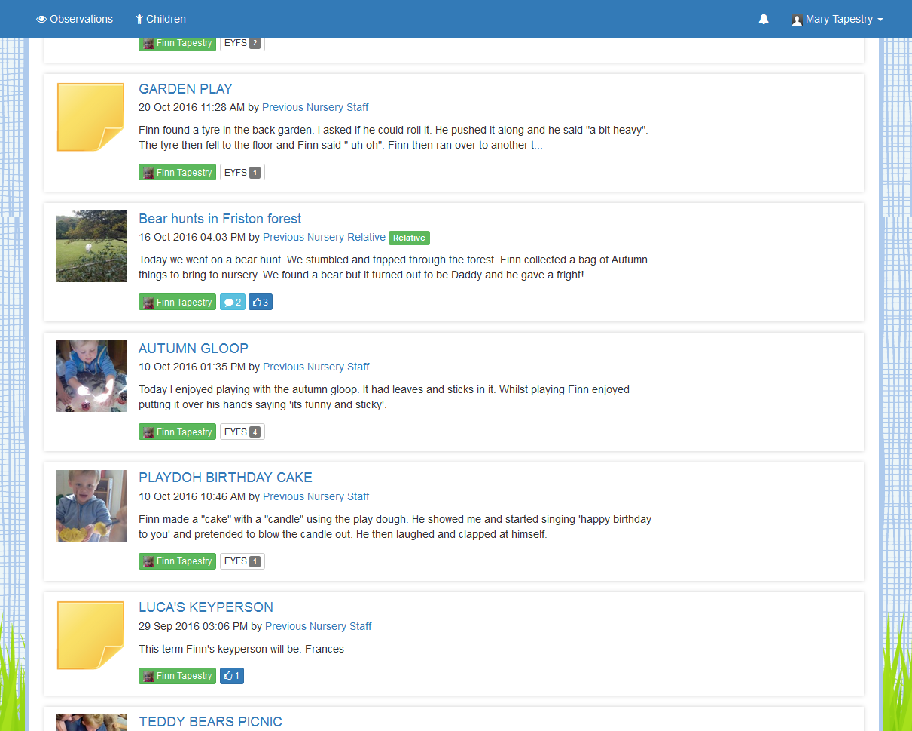
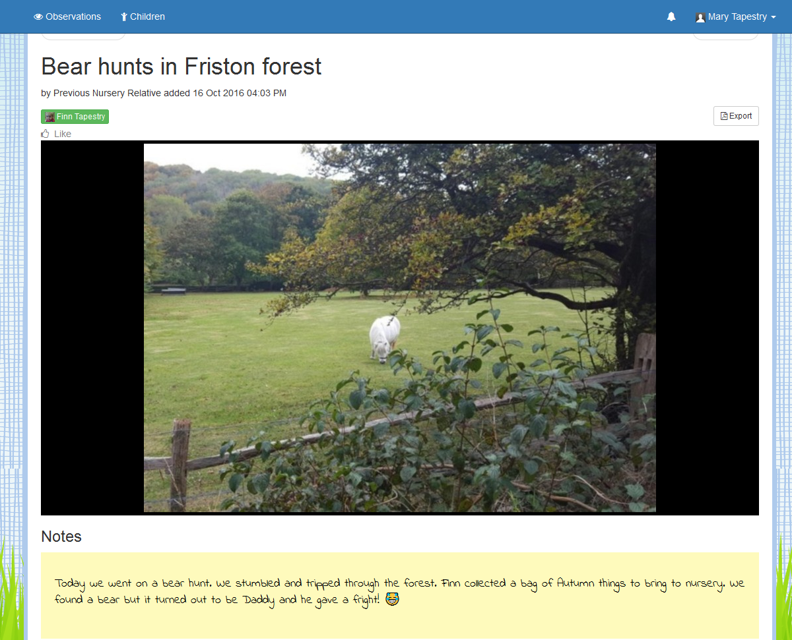
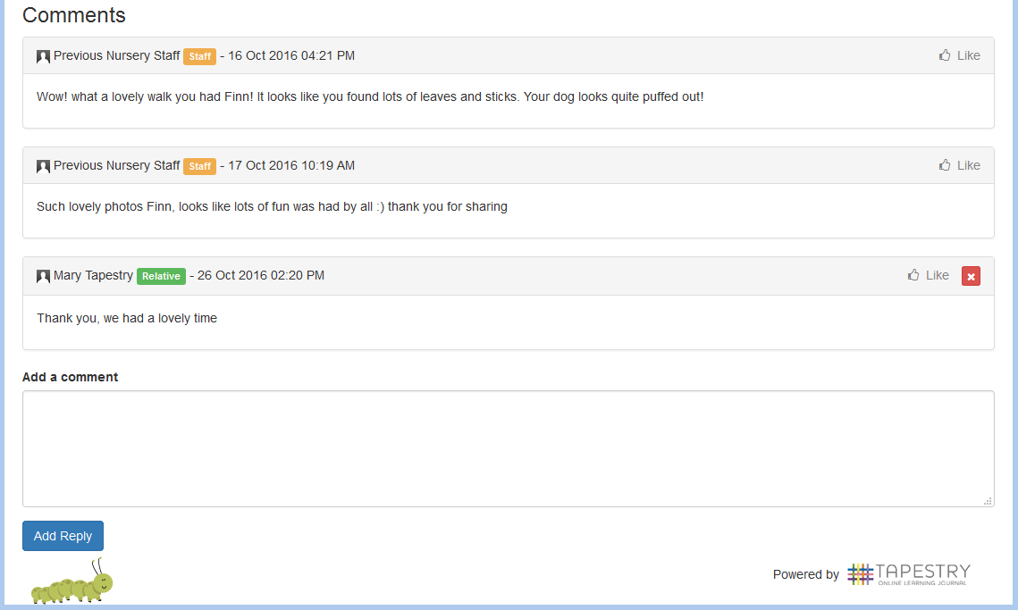
What Does It Look Like?

Slide 7
We will shortly hand out introductory letters so you can grant your permission and provide an email address
We should have your account created by Monday 5th February, and you will receive a link to set a password for yourself
When Will We Get Started?

Slide 8
If you have any questions, please ask
as you collect your form.

