Slide 1
The Arctic and Southern Oceans
Wednesday 27th January 2021

Slide 2
The Arctic Ocean
This is the smallest ocean and is located around the North Pole across the Arctic Circle.
It gets it’s name from the word ‘arktos’ which means ‘bear’ in Greek.
Often it is completely covered in ice.

Slide 3
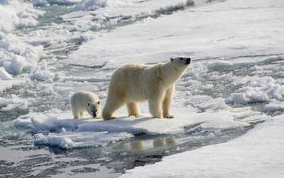
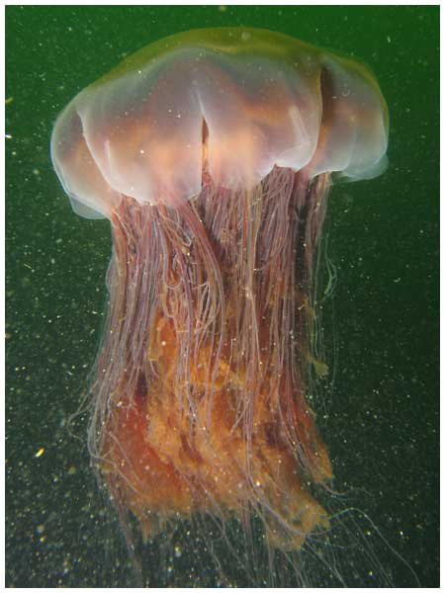
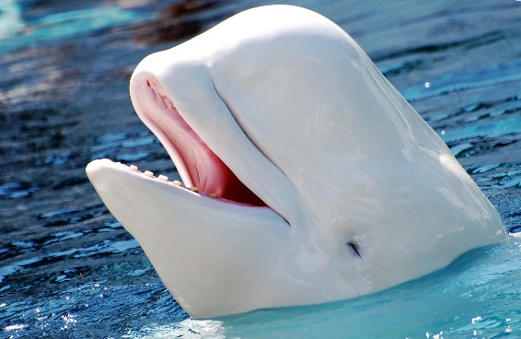
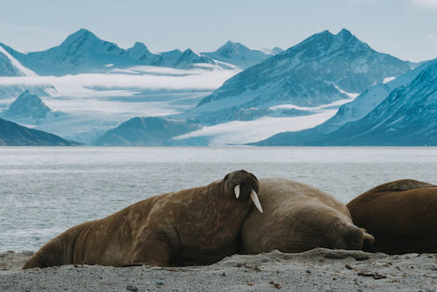
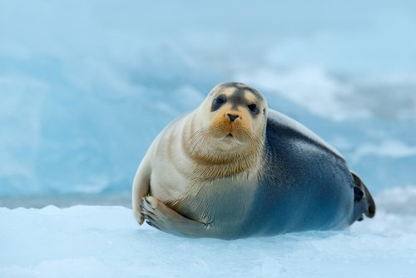
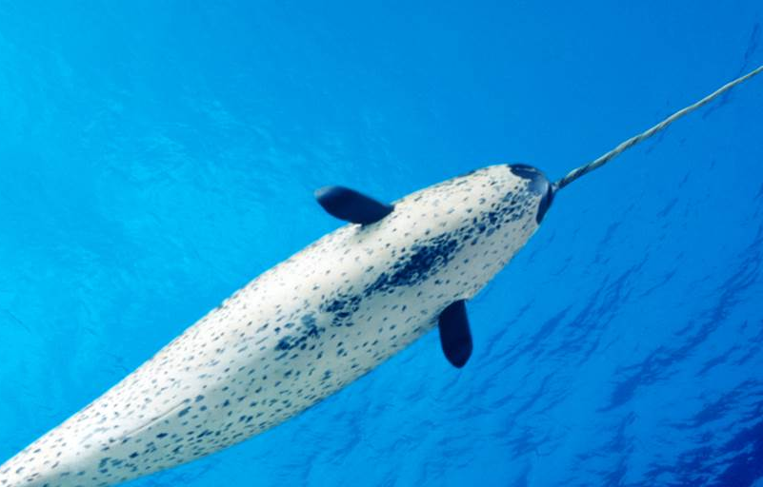
The Arctic Ocean
1.
Examples of some of the species found in the Arctic:
1.Polar Bear
2.Lion’s Mane Jellyfish
3.Beluga Whale
4.Walrus
5.Seal
6.Narwhal
2.
3.
4.
5.
6.

Slide 4
The Arctic Ocean
Did you know….?
1) The Arctic Ocean’s ice covers are shrinking by 8% every 10 years.
2) The temperature of the sea is -2 degrees.

Slide 5
The Southern Ocean
The Southern Ocean is located around the South Pole across the Antarctic Circle.
It is the second smallest of the oceans.
It is the coldest and wildest!

Slide 6
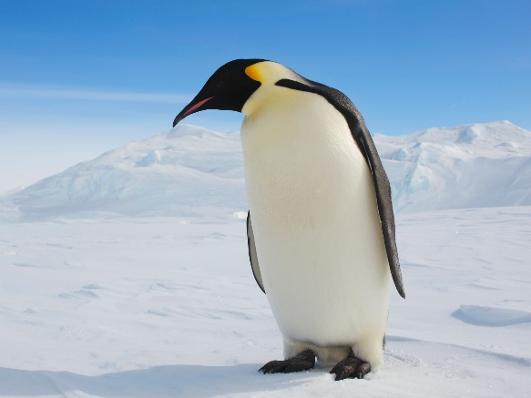
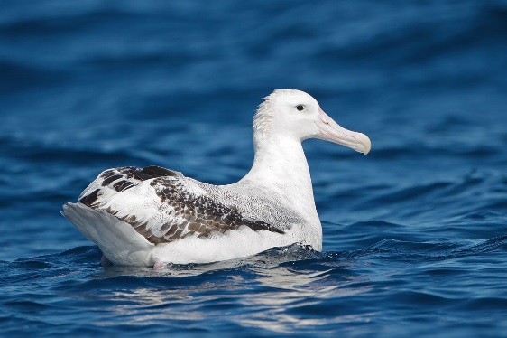
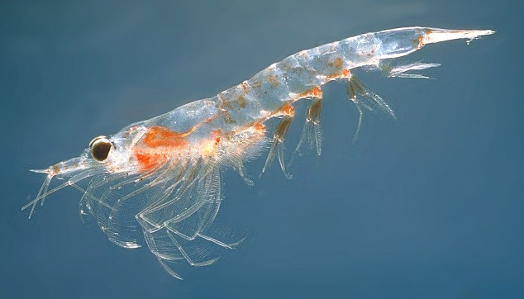
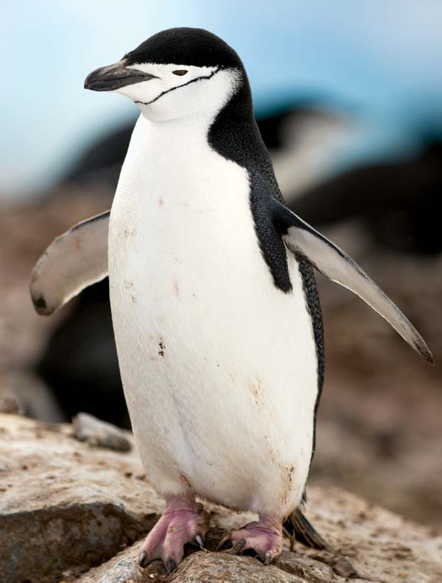
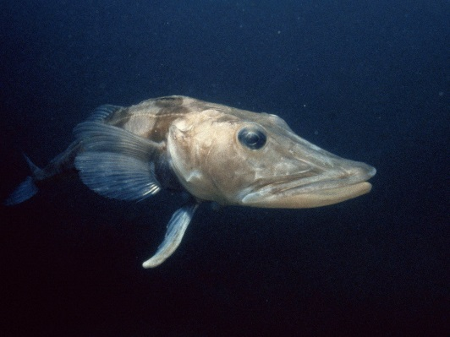
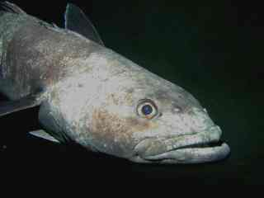
The Southern Ocean
1.
Examples of some of the species found in the Southern:
1.Emperor Penguin
2.Wandering Albatross
3.Krill
4.Chinstrap Penguin
5.Mackerel Ice Fish
6.Antarctic Tooth Fish
2.
3.
4.
5.
6.

Slide 7
The Southern Ocean
Did you know….?
1) The Southern Ocean was formed 30 million years ago.
2) This ocean covers only 6% of the Earth’s surface.

Slide 8
Today’s Activity
For your theme activity today, we would like you to continue creating your oceans fact file on both the oceans that we have explored today.
You could use the same template you have used for yesterday’s learning.
Don’t forget to upload your work onto Tapestry!

