Slide 1
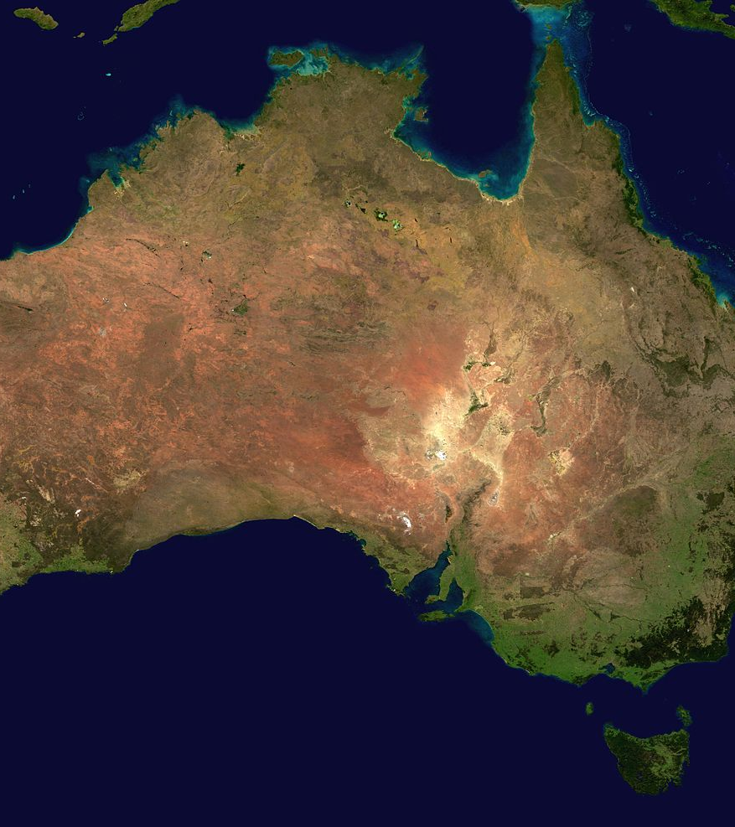
Theme Thursday 25th February 2021
LO: To identify Australian animals and their habitats

Slide 2
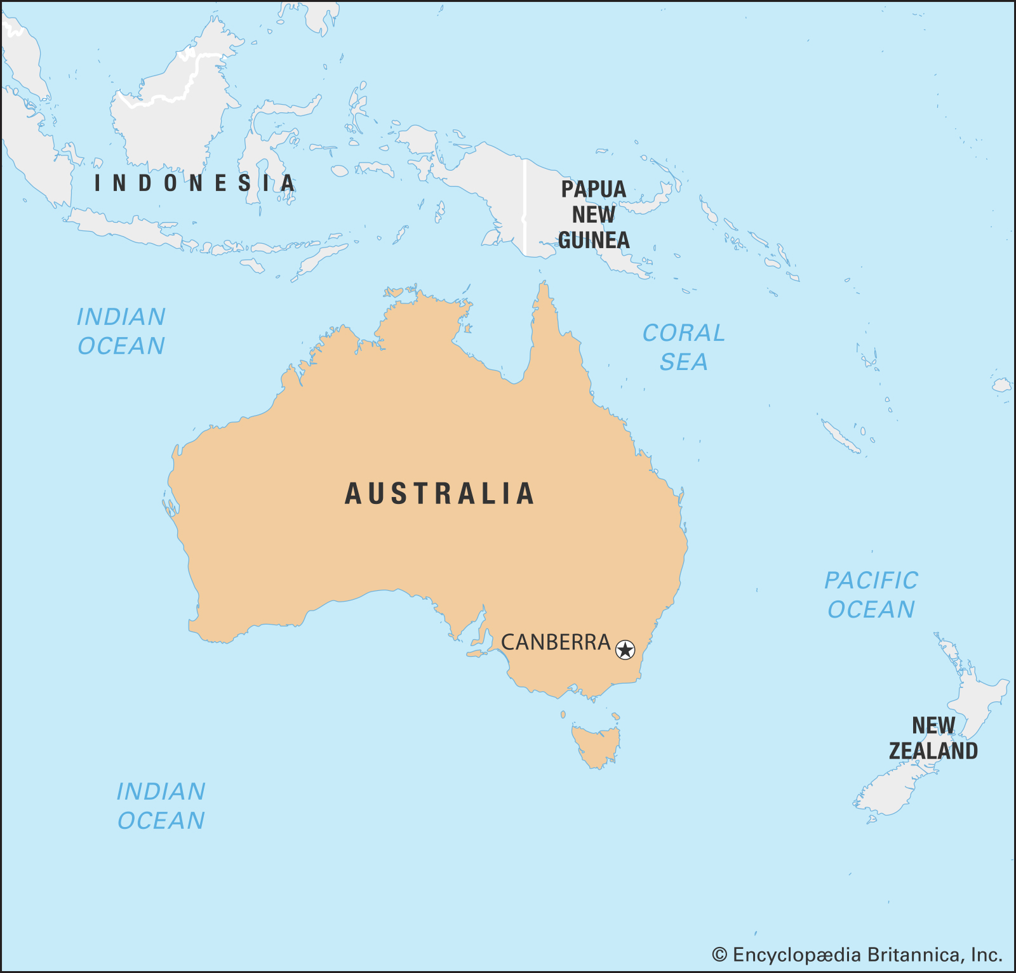
Can you name any Australian animals?
What animals live in Australia that do not live here? Does Australia have any of the same animals we do in the UK?

Slide 3
Today we are going to learn about some Australian animals and their habitat
A habitat is where an animal lives.
We are going to look at three different types of habitat. These are the Outback, the Rainforest and surrounding oceans/seas.

Slide 4
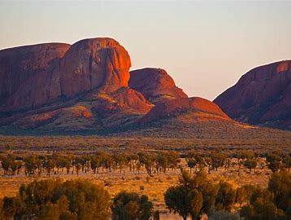
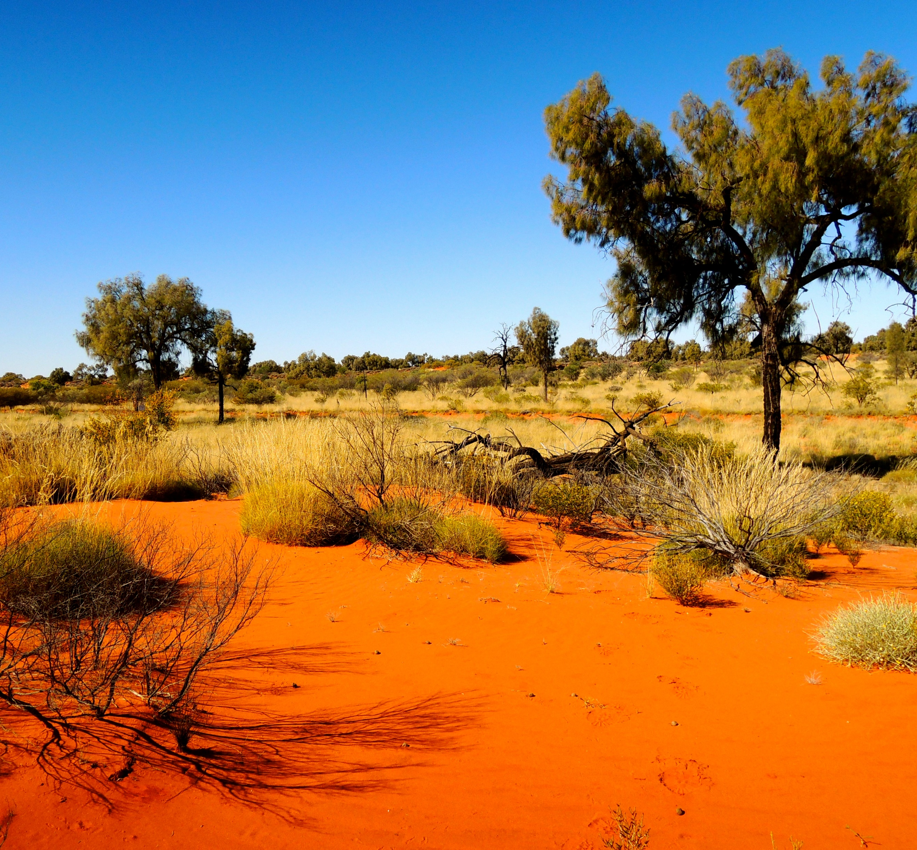
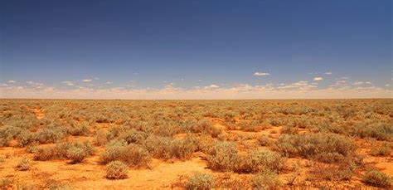
The Outback
The Outback is a huge, and very dry area of land that takes up most of Australia.
Very few people live in the Outback, but many different animals and species of plant live there.
The Outback is situated very far away from the coast and the cities of Australia.
Animals that live in the Outback need to be able to survive extremely hot and dry conditions, with little water to drink.

Slide 5
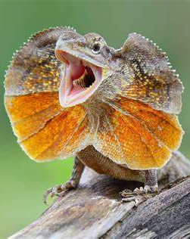
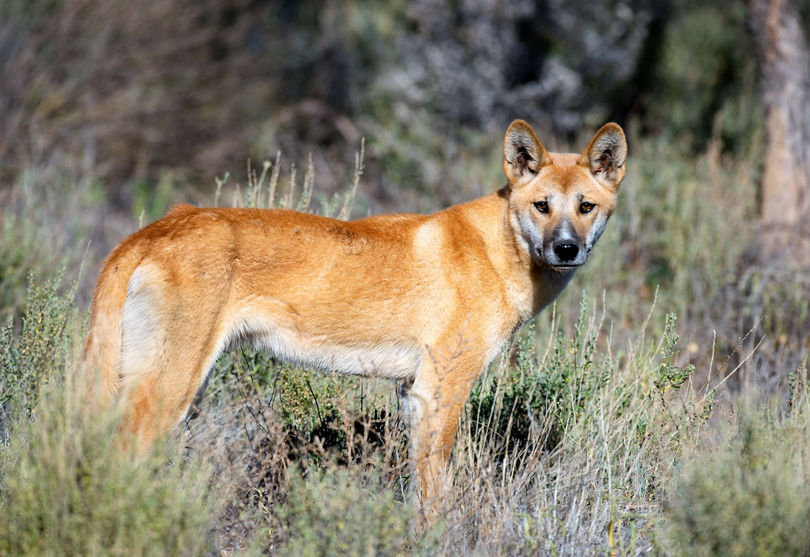
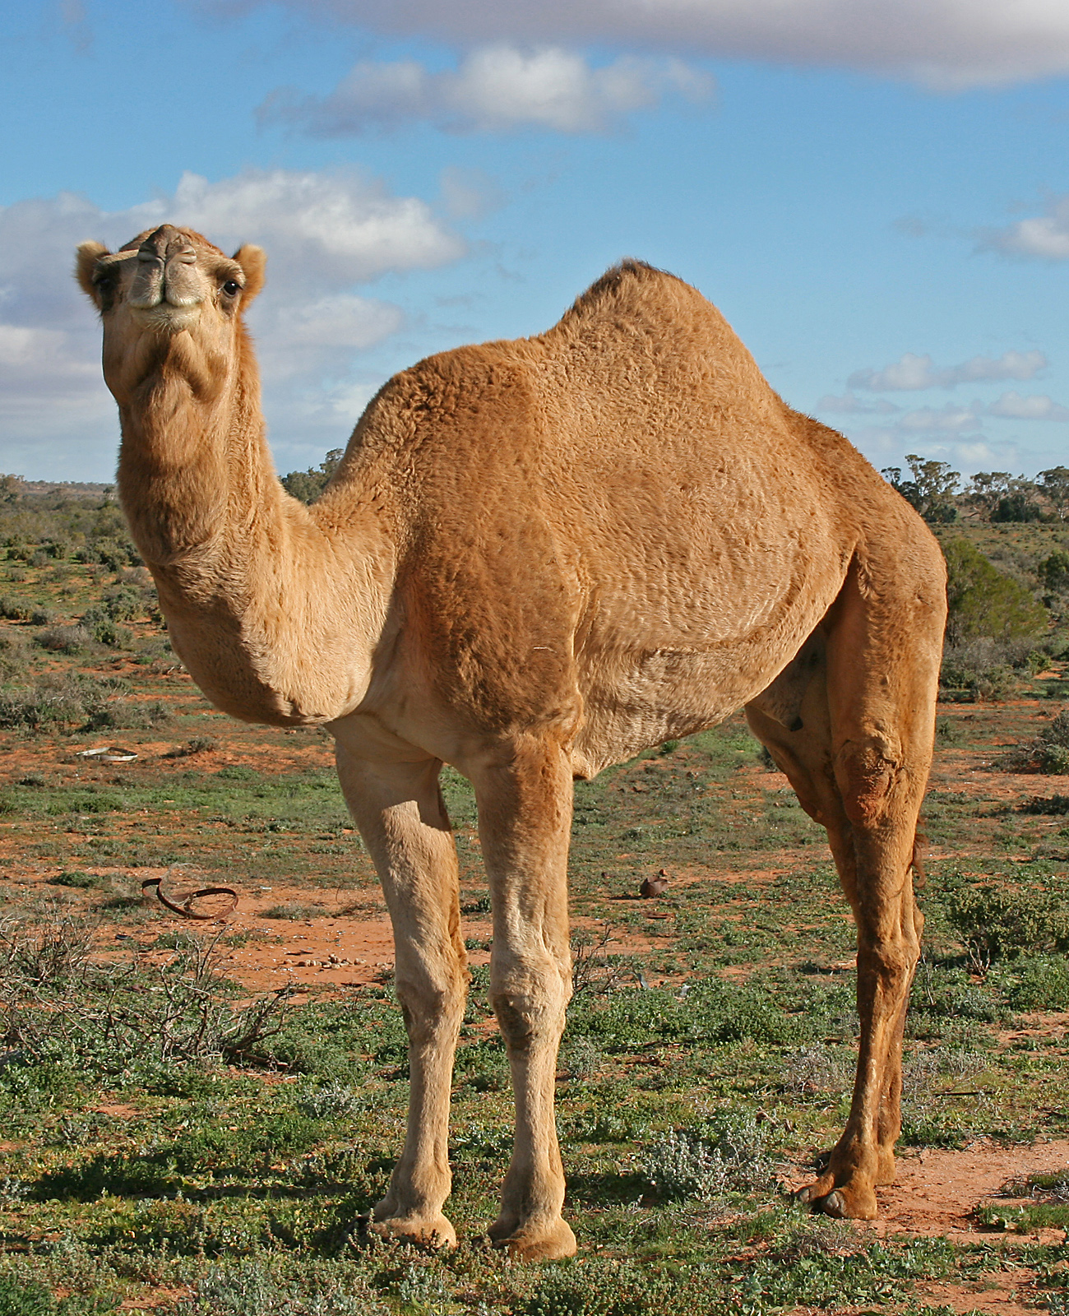
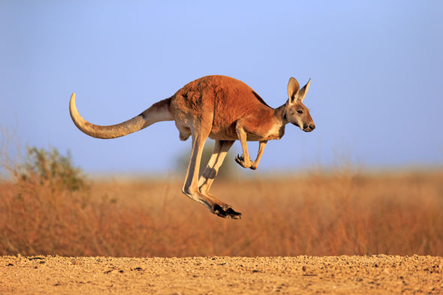
Animals that live in the outback include:
Dingos. These are wild dogs that are mammals. They are carnivores which means they only eat meat. They mostly feed on wallabies and kangaroos, but also small animals such as lizards and birds.
Australian feral camels. They are mammals and herbivores- they only eat plants and leaves. They can survive a very long time without water- much longer than humans can.
Frill- necked lizard. These are reptiles and they are carnivores. They mostly eat insects. Usually its frill lies flat on their shoulders, but when they feel irritated or threatened they will raise the frill to scare and surprise its enemies!
Kangaroos. They are mammals and herbivores. They mostly eat grass and leaves. They are known as marsupials- this means they carry their babies in a pouch.

Slide 6
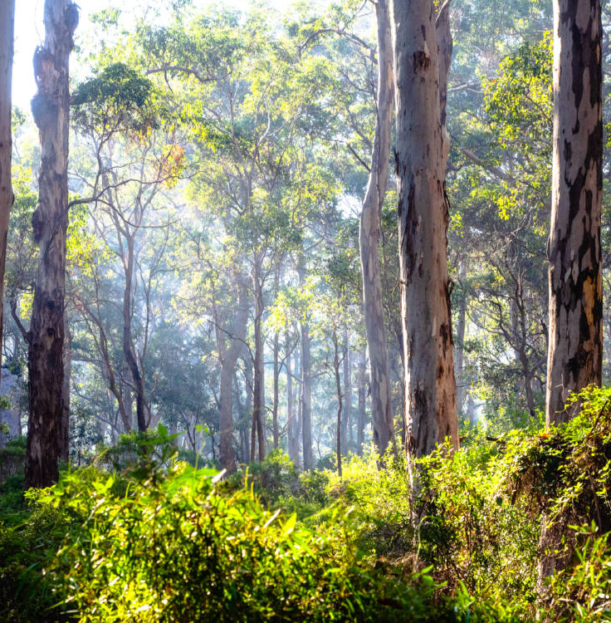
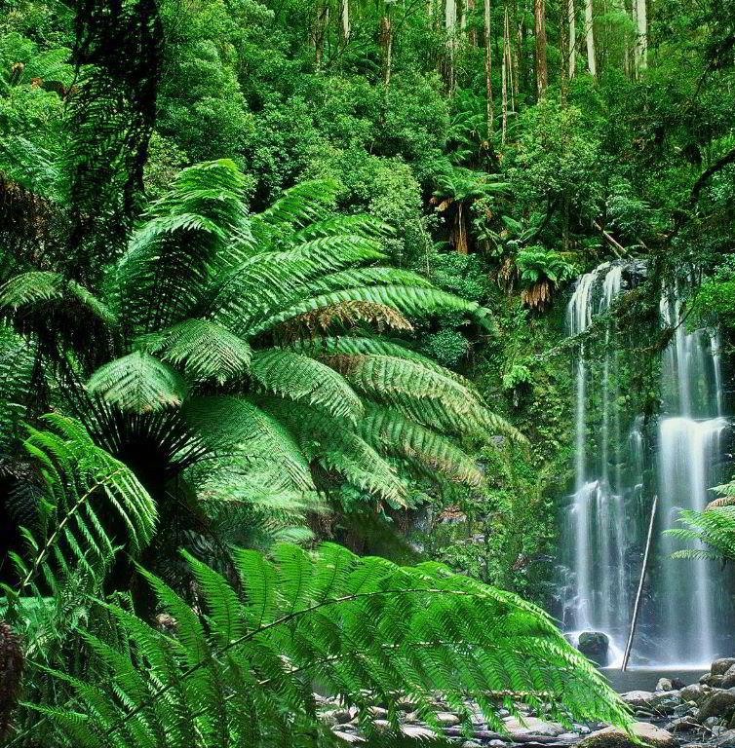
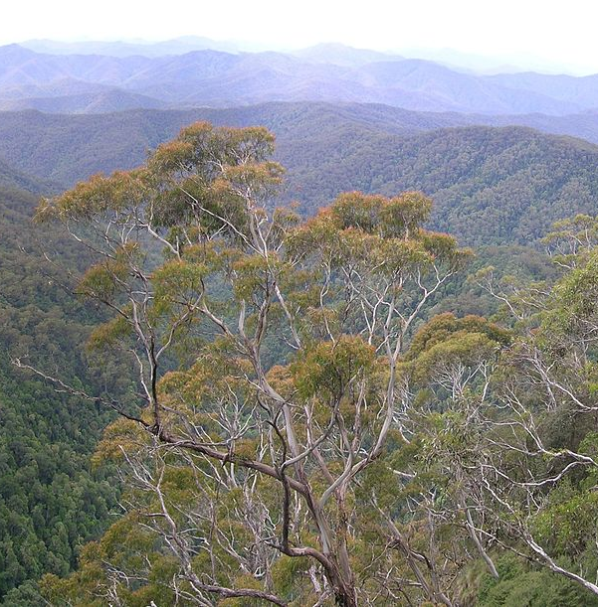
Rainforests
Australia has a huge areas of forest, mainly made up of eucalyptus trees.
As we learned in Theme yesterday, sadly Australia suffers ‘bushfires’ often which is where large areas of forest burn down.

Slide 7
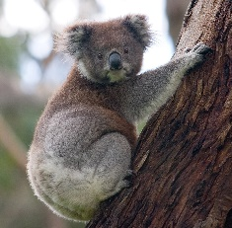
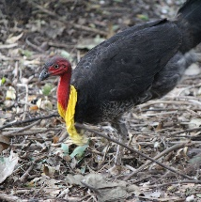
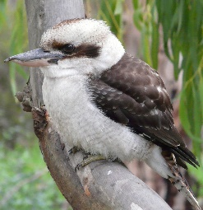
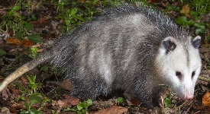
Animals that live in the forest include:
Koalas. Koalas are mammals and herbivores. They mostly eat eucalyptus leaves. They are marsupials- they carry their babies in a pouch.
Possums. Possums are mammals and they are omnivores. They eat both plants and meat, including flowers, fruit, insects and snails. They are also marsupials.
Australian brush turkey. This is a species of bird. They are omnivores and eat insects, seeds and fruit.
Kookaburra. Kookaburras are birds and they are carnivores. They eat small lizards, insects and other small birds. They are known for their ‘laugh’!

Slide 8
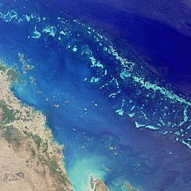
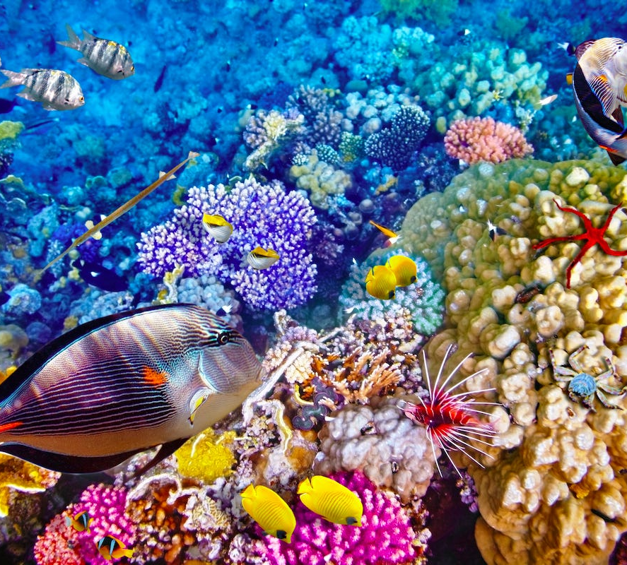
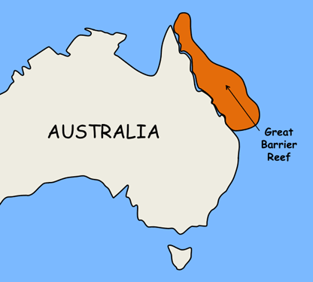
The Ocean
Australia is surrounded by the Indian Ocean, the Pacific Ocean and the Southern Ocean. It is also surrounded by the Timor, Tasman and Coral Seas.
The Great Barrier Reef is located in the Coral Sea, off the east coast of Australia. It is made up of about 133,000 square miles and can be seen from outer space!
It is home to more than 1,500 species (different types of) fish and 134 species of sharks and rays.

Slide 9
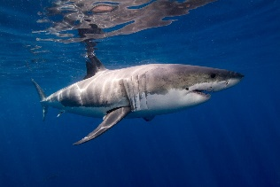
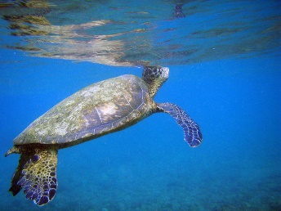
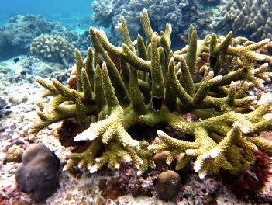
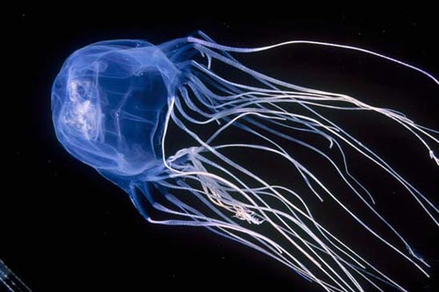
Animals that live in Australia’s surrounding oceans and seas include:
Great White Shark. They are a type of fish and are carnivores. They eat other fish and seals. They weigh around 2.5 tons- that’s about the same as 2 and a half small cars!
Flatback sea turtle. They are reptiles and omnivores. They eat jellyfish, coral, shrimp and sea cucumbers, as examples.
Box jellyfish. They are carnivores and eat fish, plankton and other jellyfish. Its sting is deadly and they are considered the most venomous jellyfish in the world.
Hard coral. Coral is actually a living marine animal. Like plants, coral needs sunlight to survive.

